Slide 1
BlackJack Simulation
Group name: 21
Himakar Kadiri, Jin Kim, Trystan MacInnes, Thuan Tran

Slide 2
Overview
BlackJack: Also knowns as 21 Battle between dealer and players. Players trying to reach 21 or higher than the dealer, without going over 21.
Special game in which probability, statistics affect the outcome
Playing with Odd: plays as the perfect card counter
Playing Normally: plays the same way as the dealer
Playing Randomly: plays based on random numbers

Slide 3
Our simulation
Interests:
What is a good way to play that minimize/increase the win ratio of playing ?
Is there a positive correlation between how much we win versus the number of rounds
What ways to play gain/lose chips the most

Slide 4
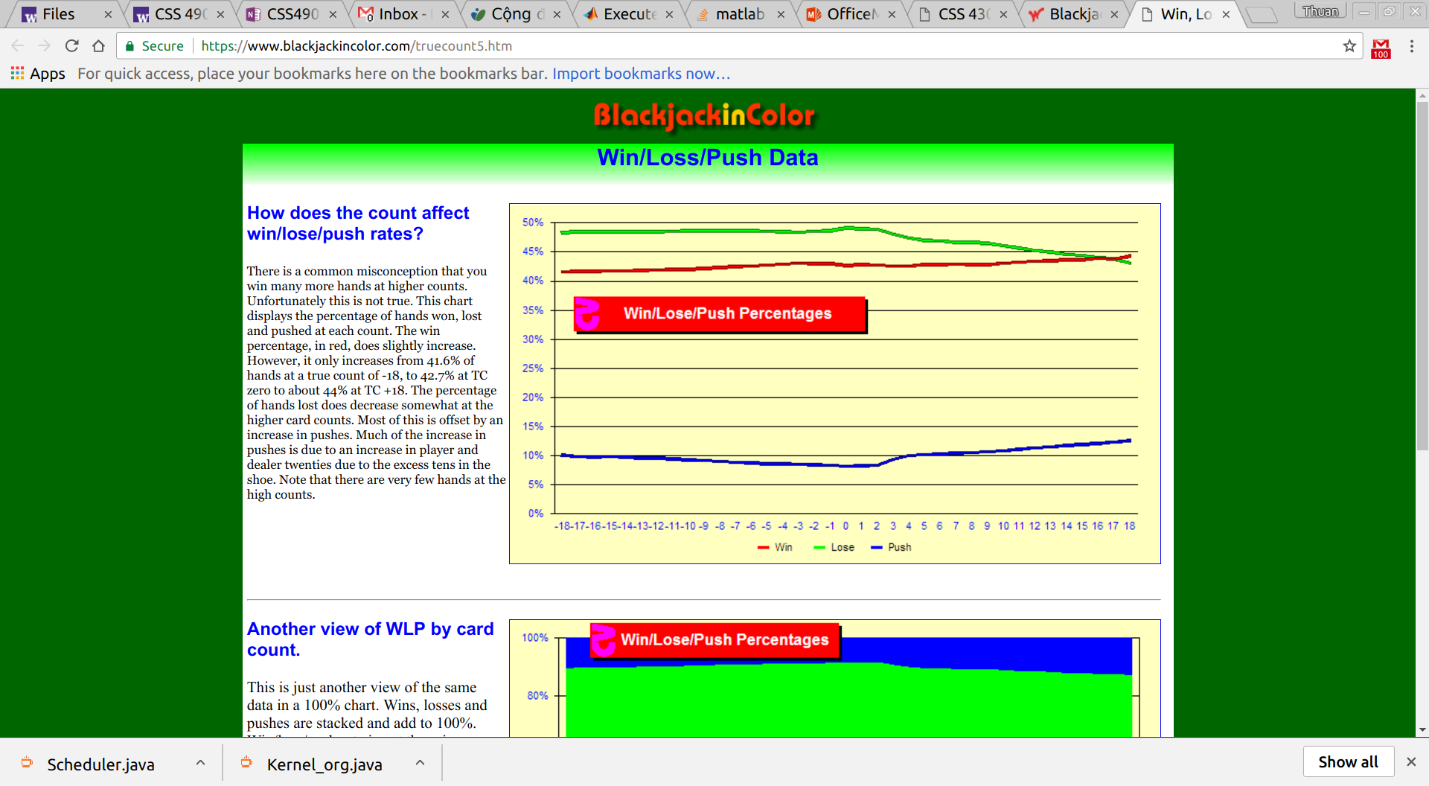

Slide 5
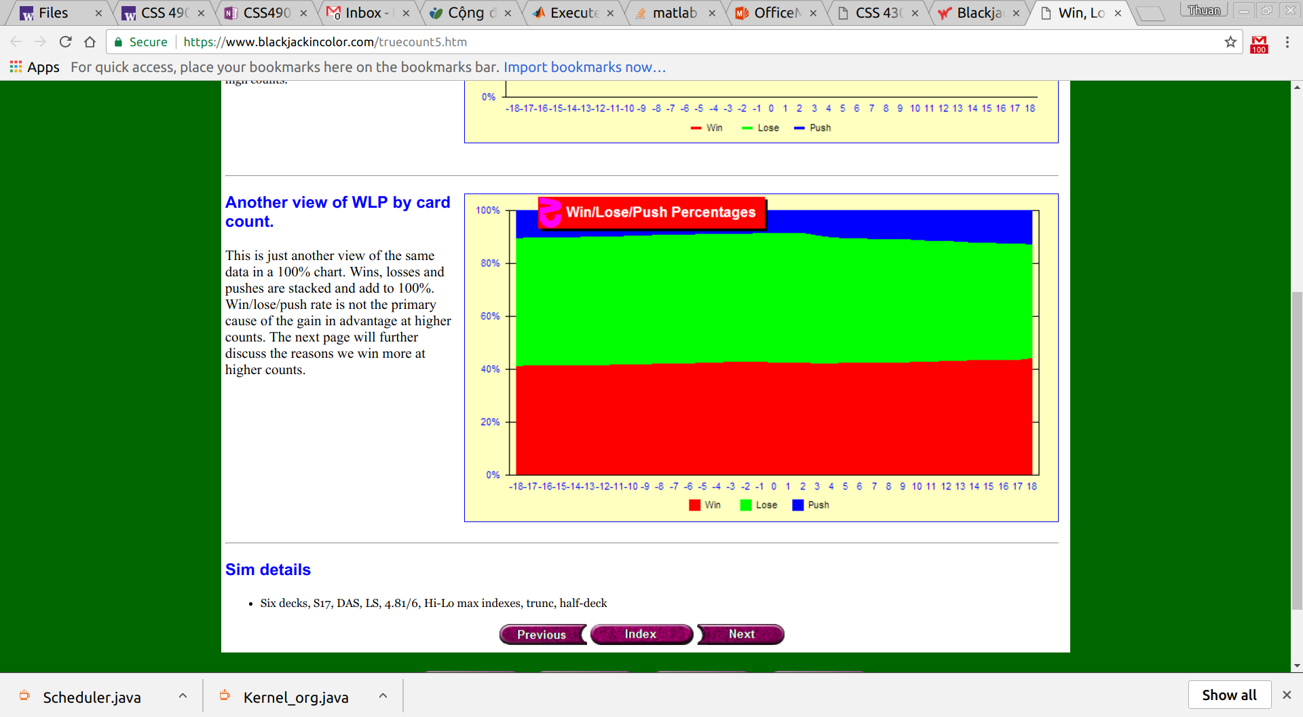

Slide 6
Model Description
Actual BlackJack game with variables that allow user to change
Card.py
Global.py
Visualize.py
Dealer.py
Player.py

Slide 7
Global.py
Allow customization of the BlackJack game
Some variables users can change:
Number of players
Number of decks
Starting Chips
Number of rounds
Number of games

Slide 8
Card.py
Represent an actual deck of card. An array that holds all the value in a 52-card deck.

Slide 9
Dealer.py
An actual dealer in a blackjack game. Can be used to distribute cards to players, collect chips from player
Follow a predefined way to play: Hit until 17 then stop

Slide 10
Player.py
Can hit, double, stand, place a bet…
Has 3 different ways to play:
Play Normal: Follow a predefined way
Play Random: Like random walk
Play with odds: Calculate the probability of whether should hit or not

Slide 11
Visualize.py
The central part of the simulation. Where all the plottings , statistics and different ways to play is used
Able to write to a text file the detail of the simulation or printing to the console

Slide 12
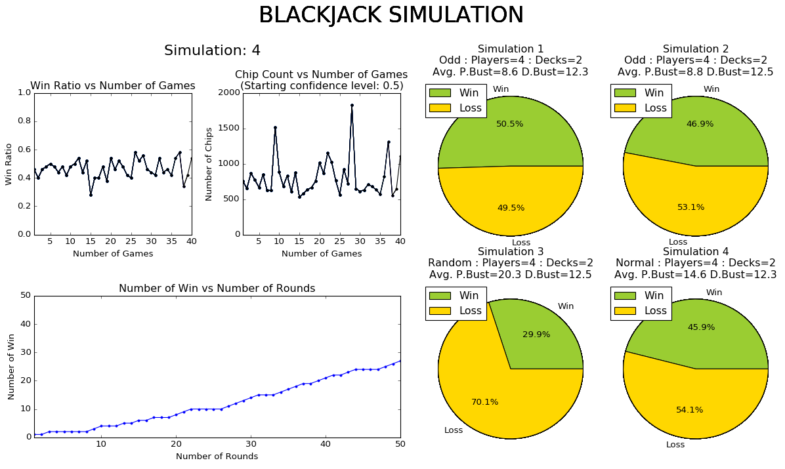

Slide 13
Analysis
Playing with odds yield the highest winning ratio: 45 - 50%
Playing Normal is about 40 - 45%
Play random is kinda low: 20 - 30%
Win ratio hardly go over 60% => This game is hard to win, beneficial for the dealer
Positive correlation between number of wins versus number of rounds.

Slide 14
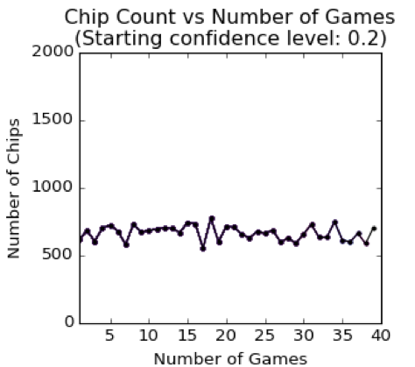
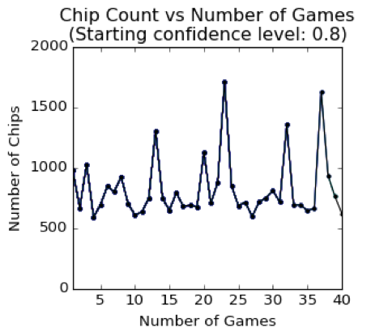
Analysis

Slide 15
Results
150 commits
960 LOC
Lots and lots of caffeine
Source code available at : https://github.com/RilThunder/CSS-458-In-Class/

